Slide 1
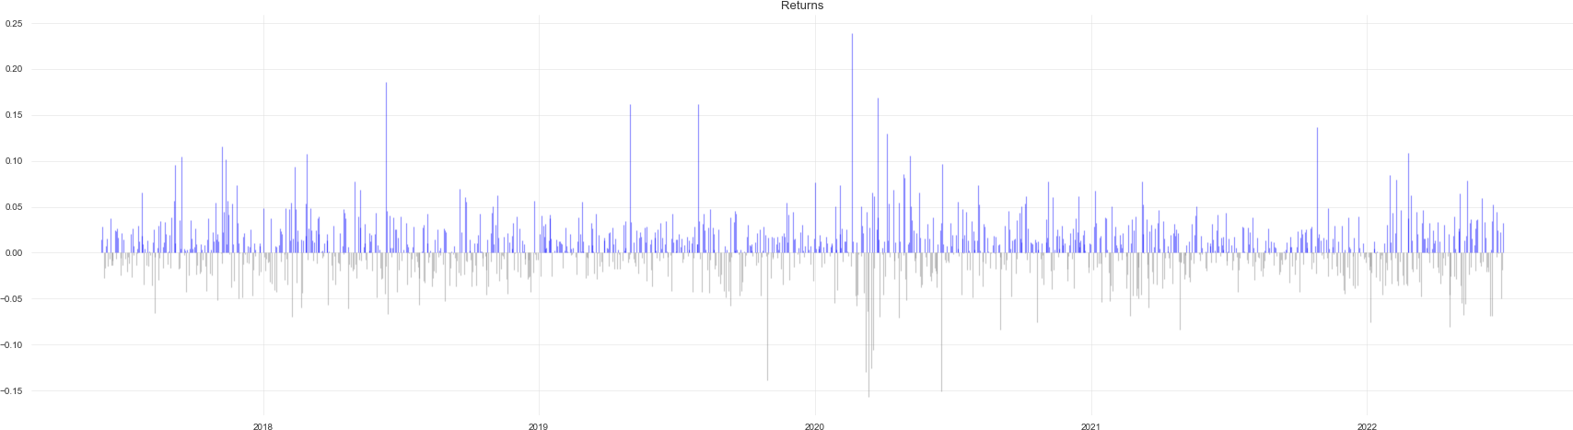
Report
Start date: 2017-06-01
End date: 2022-07-01
Annual return: 121.81%
Cumulative return: 5619.58% Annual volatility: 50.32 % Winning day ratio: 56.41 Sharpe ratio: 1.83
Calmar ratio: 2.76
Information ratio: 0.01
Stability: 0.97
Max drawdown: -44.12 % Sortino ratio: 2.97
Skew: 0.61
Kurtosis: 6.45
Tail ratio: 1.18
Common sense ratio: 1.63 Daily value at risk: -5.0 % Alpha: 1.15
Beta: 1.23

Slide 2
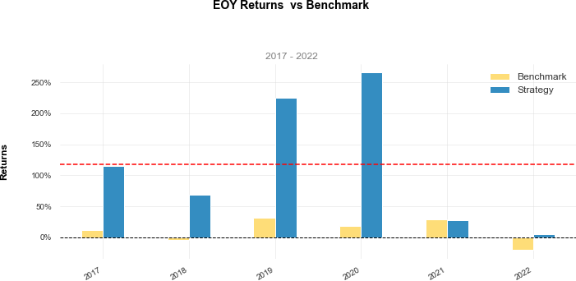
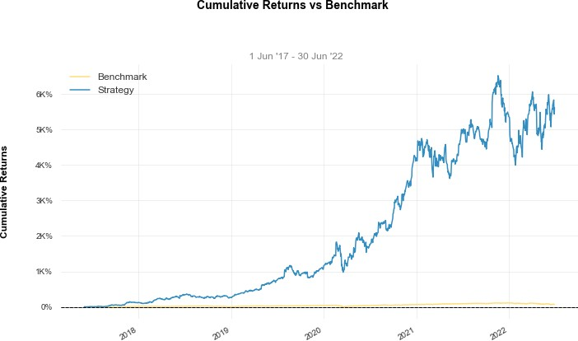

Slide 3
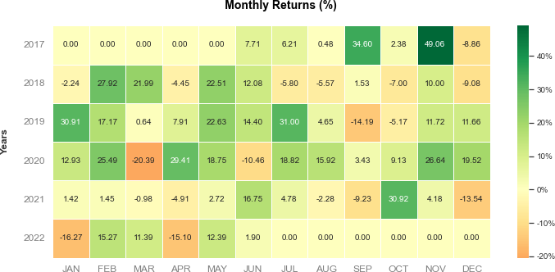
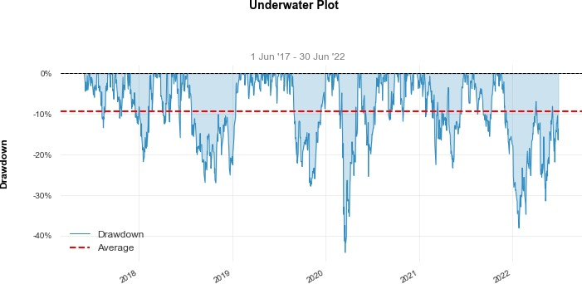
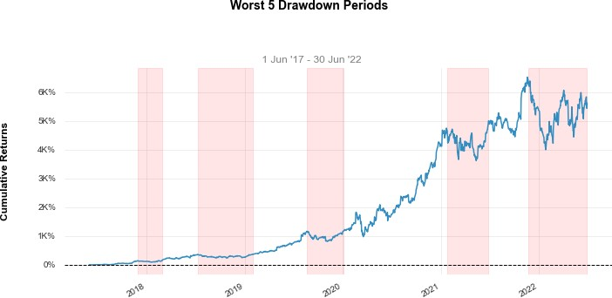

Slide 4
